Slide 1

AI World Models Revolution 2026
Beyond Language: How AI Is Learning to Understand Space, Time & Reality Itself
16 JANUARY 2026

Slide 2

Industry Shakeup: The $5 Billion World Model Race
Yann LeCun's Bold Move
Google DeepMind Strikes
Meta Doubles Down
Meta's Chief AI Scientist departs to launch groundbreaking world model startup, targeting an unprecedented $5 billion valuation in the spatial AI revolution
Genie 3 released with state-of-the-art capabilities, setting new benchmarks for realistic virtual environment generation and 4D scene understanding
Expanding robotics division with world model integration, positioning for leadership in physical AI and embodied intelligence systems
The race to dominate spatial AI is accelerating faster than anticipated, with major players committing billions to world model development

Slide 3
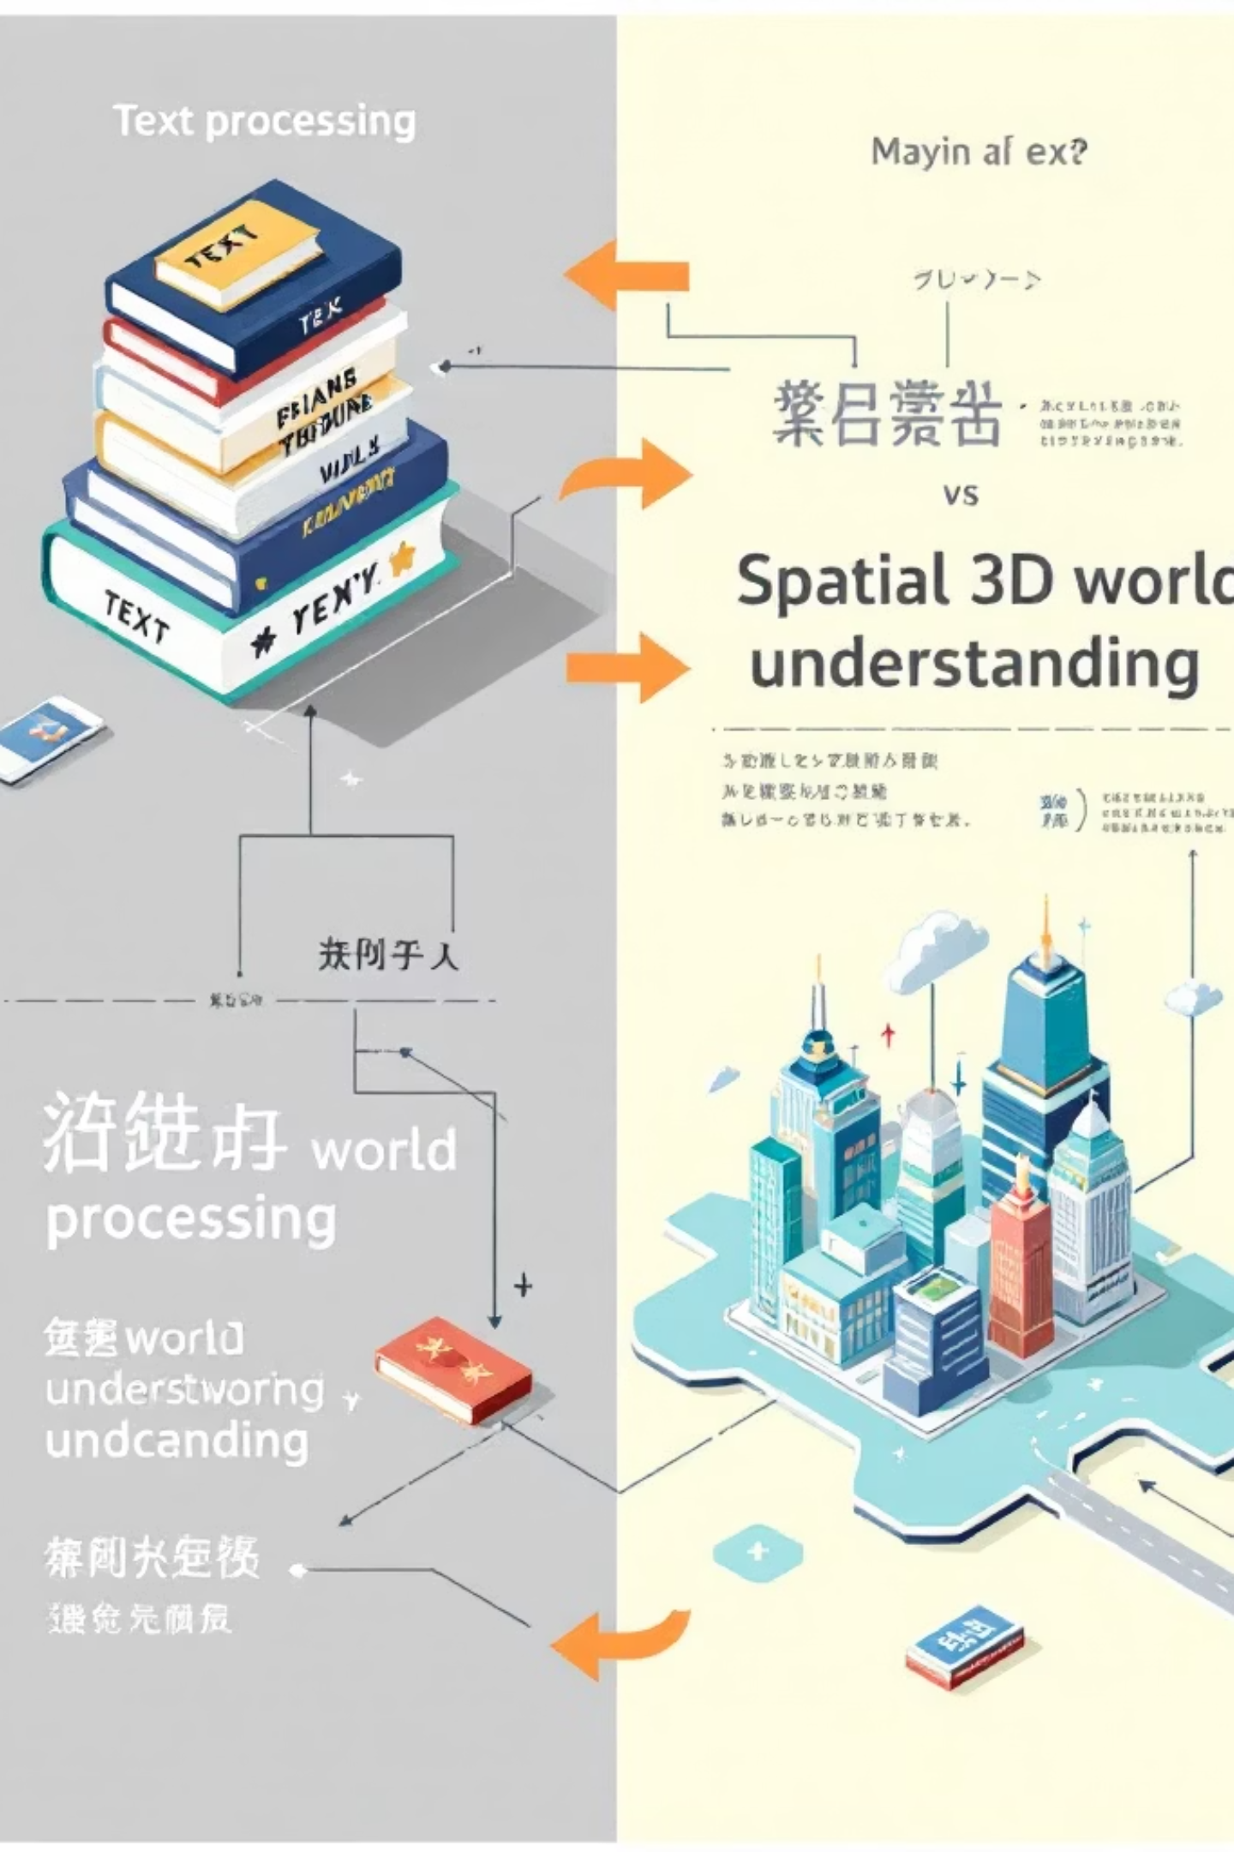
What Are World Models?
Language Models (LLMs)
World Models
Traditional AI systems predict the next word in a sequence, processing information as one-dimensional text streams. They understand language patterns and relationships between words but lack comprehension of physical reality, spatial relationships, or how objects move and interact in real environments.
Next-generation AI systems that predict the next frame in physical reality, understanding how things move, interact, and change in 4D space (3D geometry plus time). They learn the physics, causality, and spatial relationships that govern our physical world.
World models represent a fundamental shift from understanding language to understanding reality itself

Slide 4


The Fundamental Difference: From Words to Worlds
Language Models
World Models
Text-based sequential processing
One-dimensional information flow
Pattern recognition in written language
No understanding of physical space
Training on billions of words
Spatial understanding across 4D
Multi-dimensional perception
Physics and causality awareness
Object permanence and tracking
Learning through visual experience
World models don't just process information—they comprehend how reality works, enabling AI to interact meaningfully with physical environments and predict consequences of actions.

Slide 5
Market Analysis: The $5 Billion Opportunity
$5B
60
4D
2026
Startup Valuation Target
Frames Per Second
Spatial Dimensions
Mainstream Adoption
Yann LeCun's ambitious funding goal signals massive investor confidence in spatial AI's transformative potential
Real-time video processing capability achieved, enabling seamless interactive applications and live environments
Understanding three-dimensional space plus time creates unprecedented ability to model reality's continuous nature
Industry analysts predict widespread commercial deployment begins this year, marking the shift from research to production
Major technology companies including Meta, Google, World Labs, Alibaba, and Tencent are investing heavily in world model capabilities, creating a competitive landscape reminiscent of the early language model race.

Slide 6





The Peak Data Problem: Why Language Models Hit a Wall
Running Out of Text Data
High-quality written content on the internet is finite. LLMs have already consumed most accessible text, limiting further improvement through traditional training methods.
Copyright & Regulation
Legal restrictions and content licensing challenges make it increasingly difficult and expensive to acquire new training data for language models.
Paywalled Quality Content
The best, most accurate information is often behind subscriptions and paywalls, creating barriers to comprehensive model training.
The Solution: World models learn from videos and spatial data—an abundant resource that circumvents text data limitations while enabling richer understanding of reality

Slide 7






Seven Revolutionary Applications Transforming Industries
Robotics & Physical AI
Video Generation
Augmented Reality
Autonomous Vehicles
Creating consistent, physics-accurate videos where objects maintain properties throughout scenes without artificial glitches
Anchoring digital objects in physical space with realistic lighting, occlusions, and persistent placement across sessions
Enabling robots to navigate complex environments, predict collisions, and manipulate objects with human-like spatial understanding
Predicting pedestrian movements, vehicle trajectories, and environmental changes for safer self-driving systems
Game Development
Scientific Simulation
Generating dynamic, explorable game environments that respond realistically to player actions and maintain consistency
Modeling complex physical systems, from molecular interactions to climate patterns, with unprecedented accuracy

Slide 8
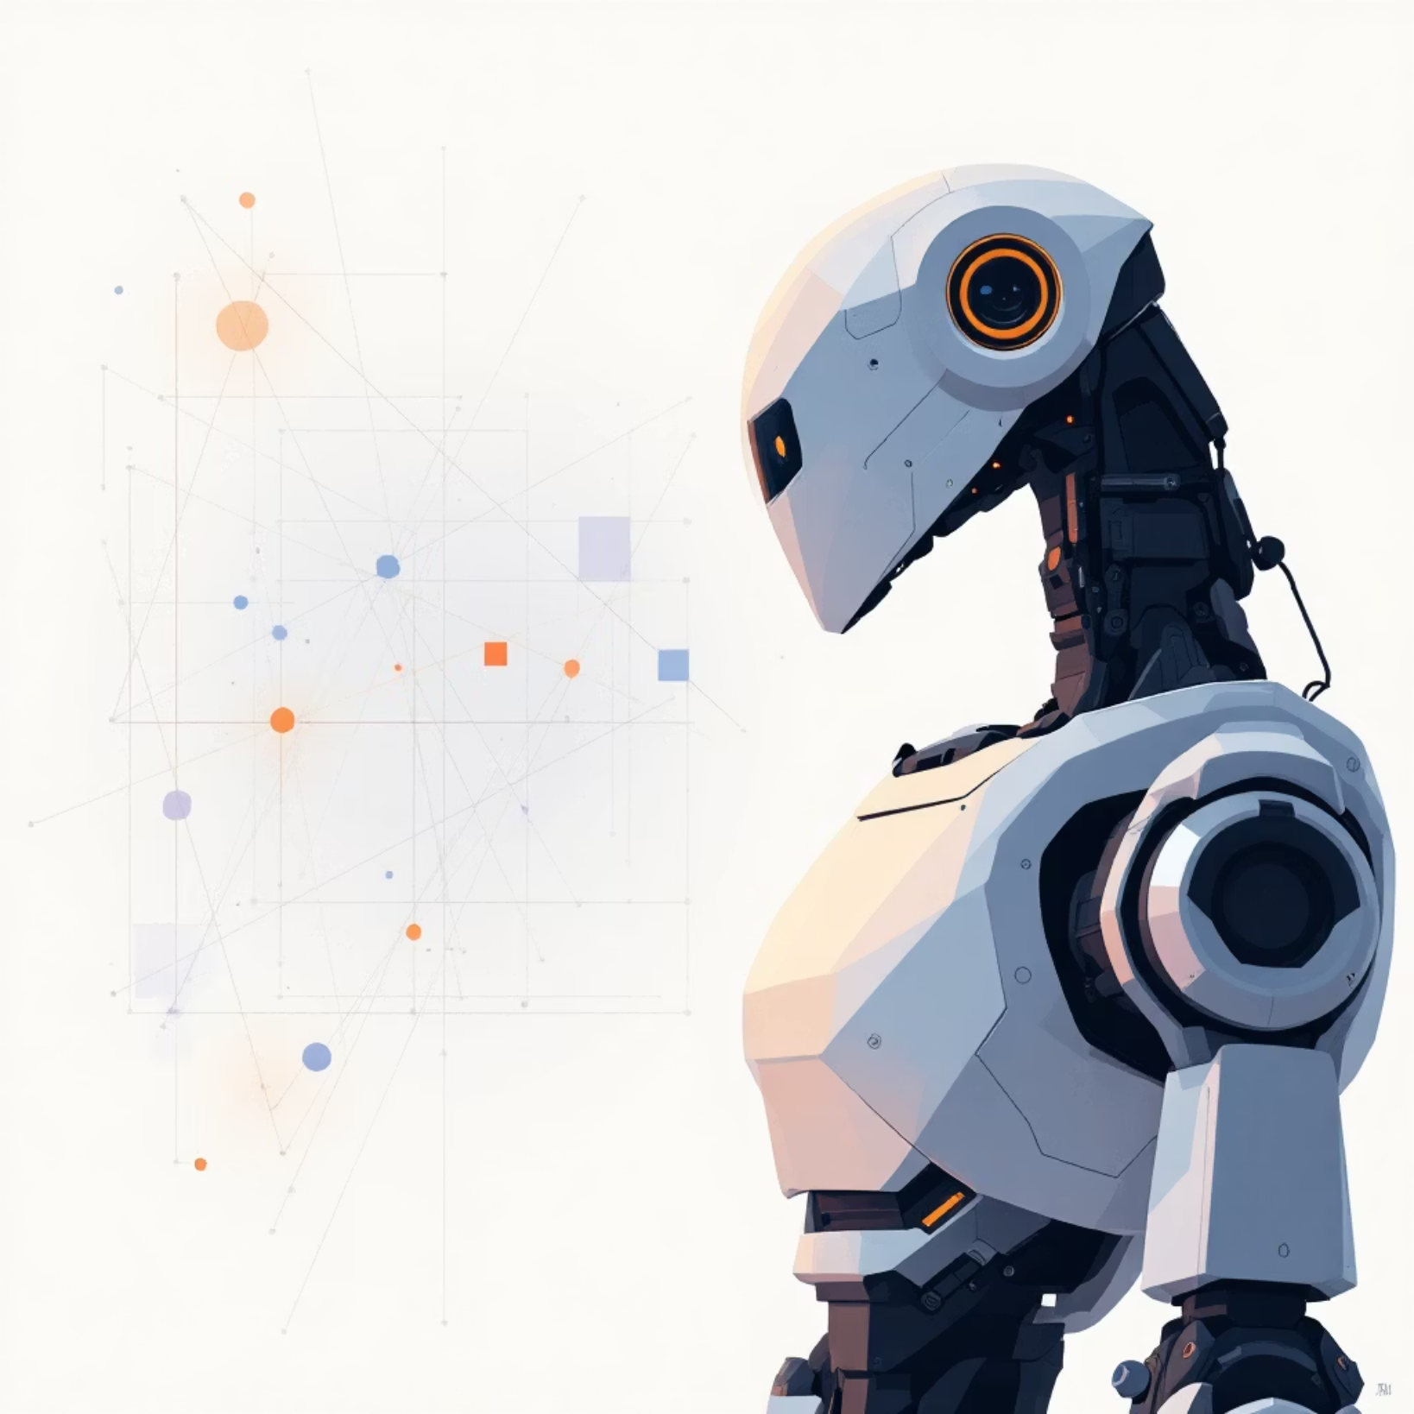
Robotics Revolution: Boston Dynamics & Beyond
Transforming Physical AI
01
3D Space Understanding
Comprehensive environmental mapping enabling navigation in cluttered, dynamic workspaces
02
Collision Prediction
Anticipating movements and potential impacts before they occur for safer human-robot collaboration
03
Complex Task Navigation
Multi-step planning with real-time adjustments based on changing conditions
04
Environment Adaptation
Learning from experience to handle novel situations without explicit programming
World models enable robots to understand not just where objects are, but how they move, interact, and change—the foundation for truly autonomous physical AI systems.

Slide 9
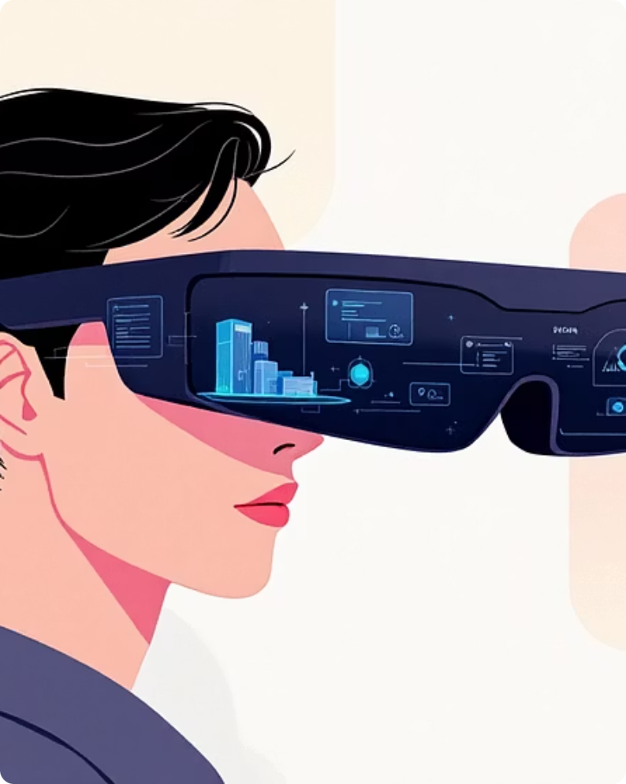

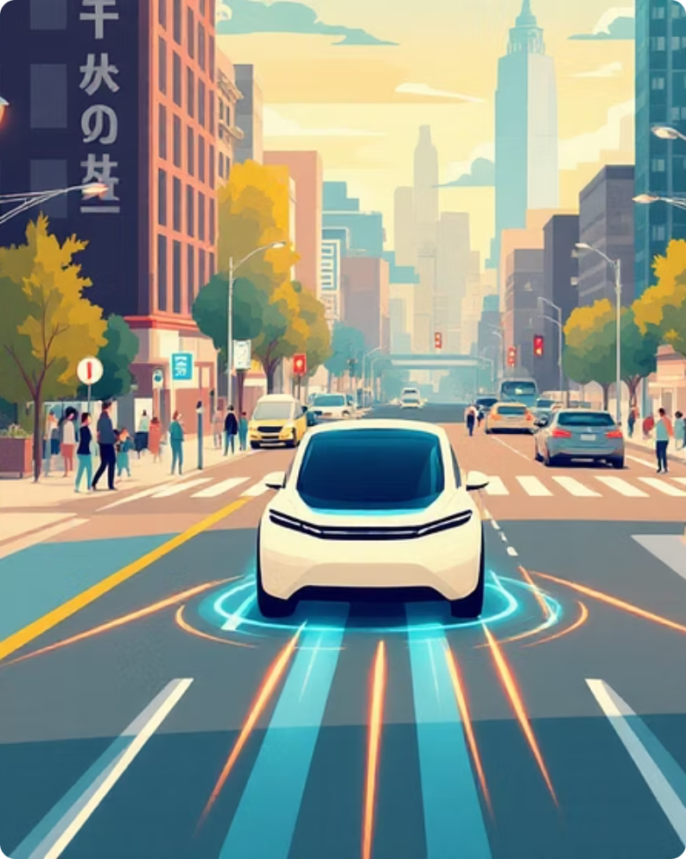
The Future of Reality: World Models Meet Business
Augmented Reality Revolution
Video Generation Consistency
Autonomous Vehicle Safety
Meta's Orion glasses demonstrate how world models enable stable object placement, realistic lighting adaptation, spatial memory across sessions, and proper occlusions—solving AR's biggest challenges.
TeleWorld, NeoVerse, and Genie 3 showcase 4D continuous representation solving the "vanishing collar" problem—objects maintain properties throughout generated videos, enabling professional content creation.
World models predict pedestrian behavior, vehicle trajectories, and environmental changes in real-time, dramatically improving safety and decision-making capabilities for self-driving systems.

Slide 10

Strategic Takeaways: The Next Competitive Battleground
Beyond Language to Physical Reality
Solution to Peak Data Crisis
World models represent the next paradigm shift in AI, moving from text comprehension to understanding how reality actually works—unlocking entirely new categories of applications.
As language models exhaust available text, world models tap into abundant video and spatial data, circumventing the limitations that constrain LLM development.
Essential for Physical AI
The New AI Arms Race
Robotics, AR/VR, autonomous systems, and embodied AI applications require spatial understanding—world models are the foundational technology making these innovations possible.
With $5 billion valuations and major tech giants investing heavily, organizations adopting world model capabilities early will gain decisive competitive advantages in the spatial AI era.
The AI revolution is shifting from understanding words to understanding worlds. Position your organisation at the forefront of this transformation.

